Slide 1
CSE-321 Programming Languages 2025
Overview
박성우
POSTECH
2025년 2월 17일

Slide 2
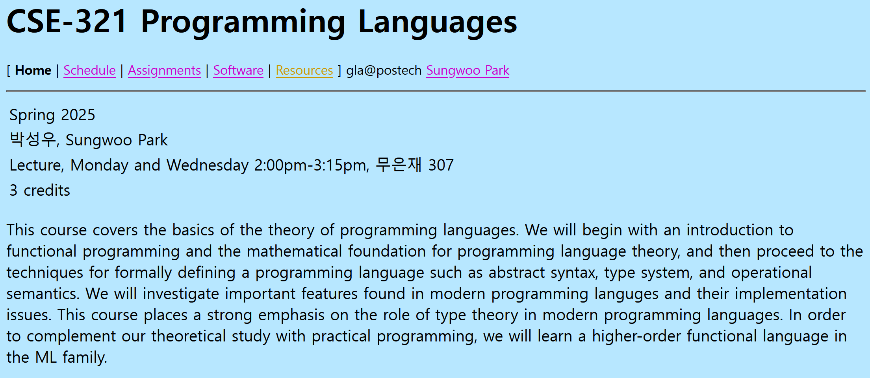
Course Webpage
http://pl.postech.ac.kr/~gla/cs321

Slide 3
Topics to be covered
Functional programming
  Objective CAML (OCAML)
  algebraic datatypes, recursive functions, tail-recursion, higher-order functions, functors
Mathematical foundation of programming languages
  inductive definition, inductive proof
Theory of programming languages
  lambda calculus
Type theory
  type safety, mutable references, subtyping, recursive types
  parametric polymorphism, type reconstruction
Implementing programming languages
  de Bruijn index, evaluation context, abstract machine, closure
Object orientation
  Featherweight Java

Slide 4
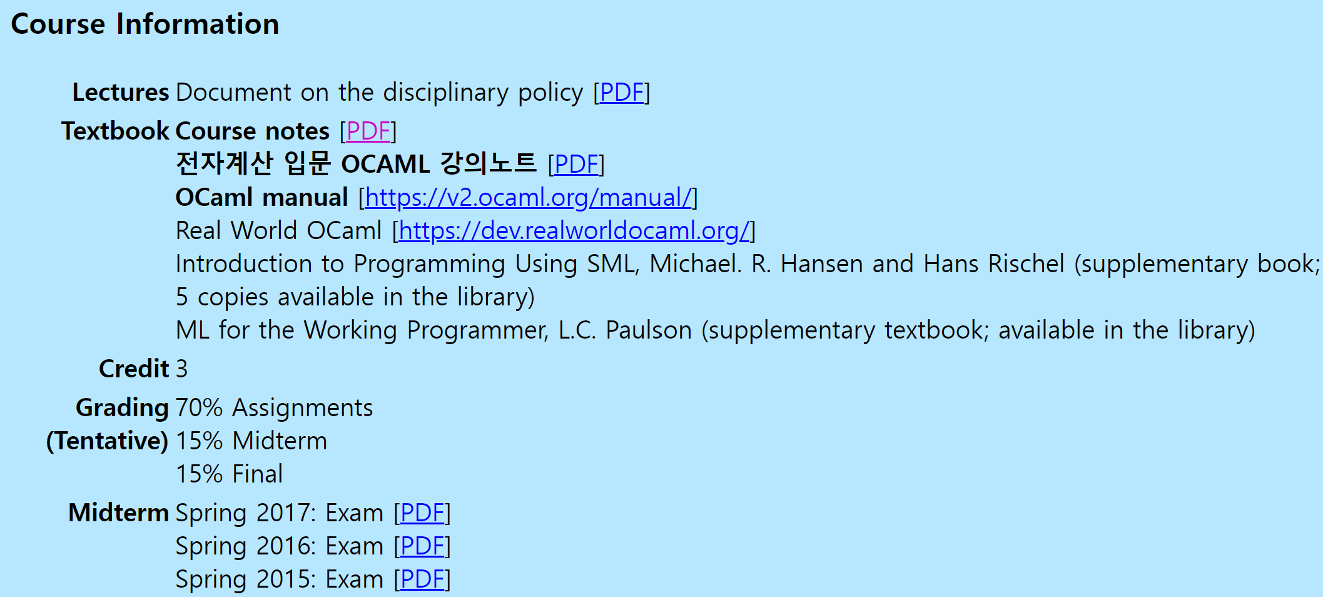
Course Information
절대 평가
출석 점수 없음
전자출결시스템 기준 1/3 이상 결석시 자동 낙제

Slide 5

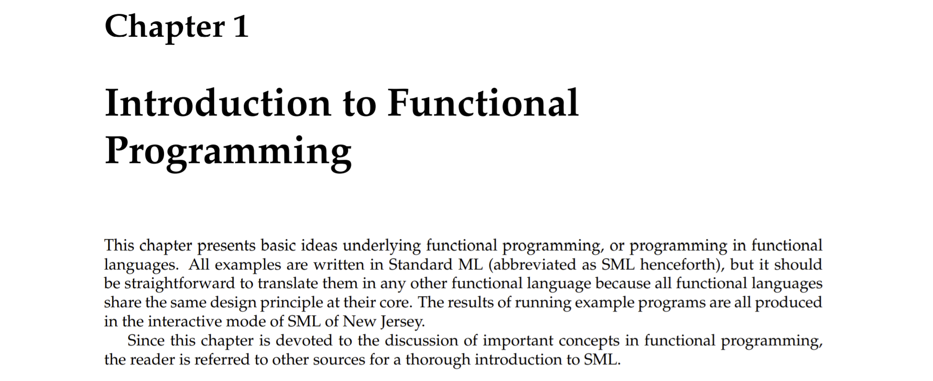
Course Notes

Slide 6
Schedule
http://pl.postech.ac.kr/~gla/cs321/schedule.html
Note
  March 5 Zoom online lecture
  May 7 Zoom online lecture
Midterm
  April 7, classroom (무은재 307), in-class (2pm - 3.30pm)
Final
  June 2, classroom (무은재 307), in-class (2pm - 3.30pm)

Slide 7
Objective CAML
Functional programming language for your assignments
OCAML 4 is required.
Do NOT use OCAML 5+ which is not compatible with some of the programing assignments

Slide 8
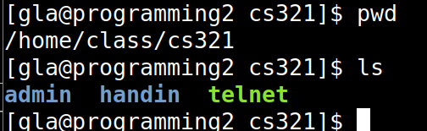
programming2.postech.ac.kr
Linux machine for your assignments
  OCAML 4.05 is installed
Use your Hemos ID to log in
Contact Hemos Team to request an ID
Your handin directory is located at:
  /home/class/cs321/handin/<your Hemos ID>
If you don't find your handin directory, email lngsg@postech

Slide 9
Programming Assignments
Programming assignments in OCAML
The first 3 programming assignments will help you get familiar with OCAML programming.
  OCAML Programming (I), (II), (III)
You may program on Windows or Linux,
but make sure that your program compiles on programing2 server.
  Otherwise your program will not be graded.
Test results will be copied to your handin directory.

Slide 10
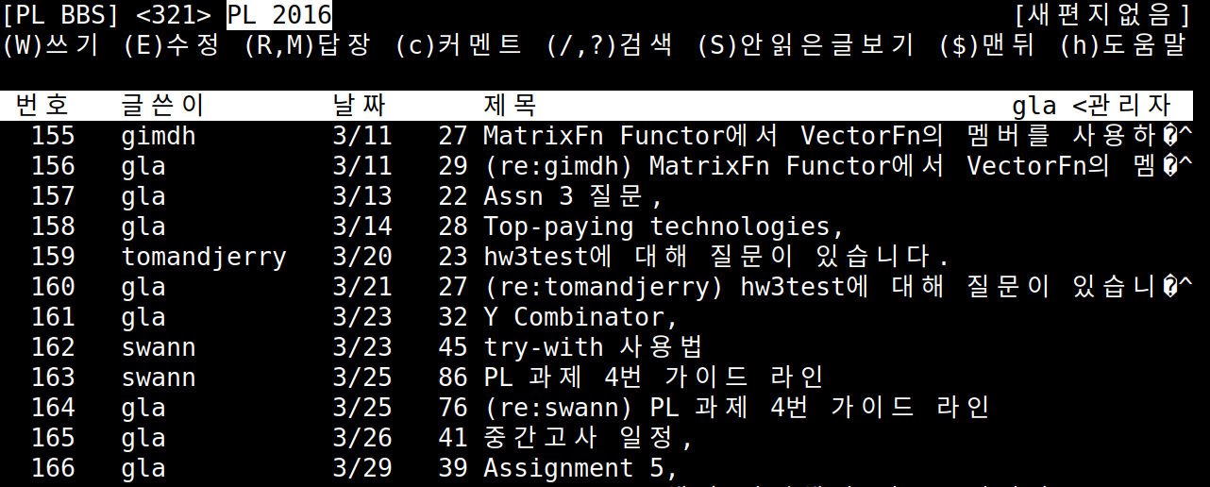
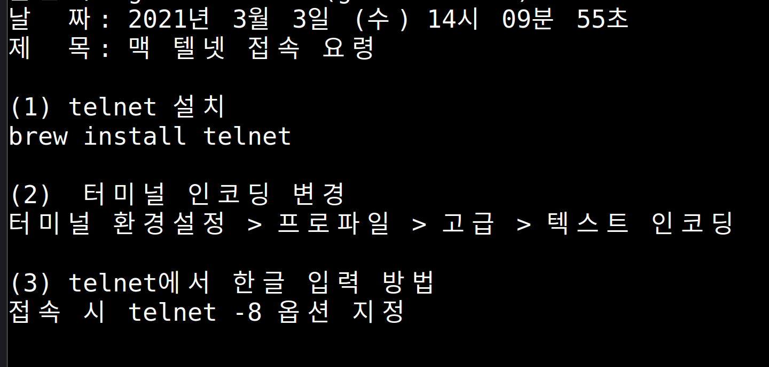
Discussion Board
Text-based (교내에서만 접근 가능)
  telnet pl.postech.ac.kr -l bbs
  board 321, encoding: euc-kr
  on programming2.postech.ac.kr, execute this command:
  /home/class/cs321/telnet

Slide 11
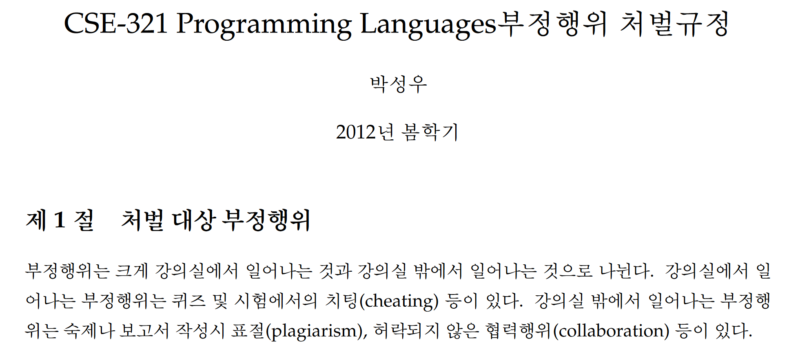
No Cheating
Read the document on the disciplinary policy.
We have developed clonechecker for OCaml.
We will check all your programs at the end of the semester.
DO NOT discuss programming assignments and exams with your classmates.

Slide 12
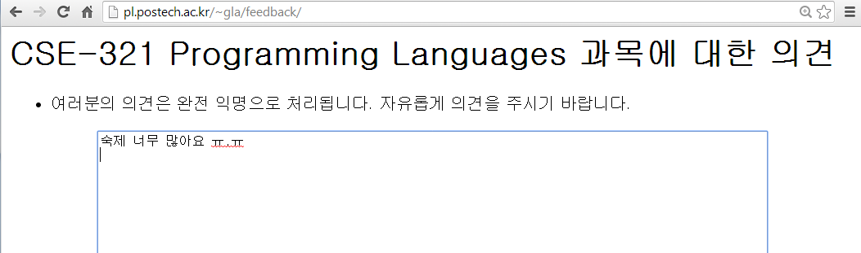
Anonymous Feedback
http://pl.postech.ac.kr/~gla/feedback/

Slide 13
Q & A

