Slide 1
CSED-321
Object Orientation
POSTECH
박성우

Slide 2
Essence of Object-Orientation (???)

Slide 3
Essence of Object-Orientation
#1. Dynamic dispatch (Multiple representation)
#2. Encapsulation, aka, Information hiding
#3. Subtyping
#4. Inheritance
#5. Open recursion (Self-reference)

Slide 4
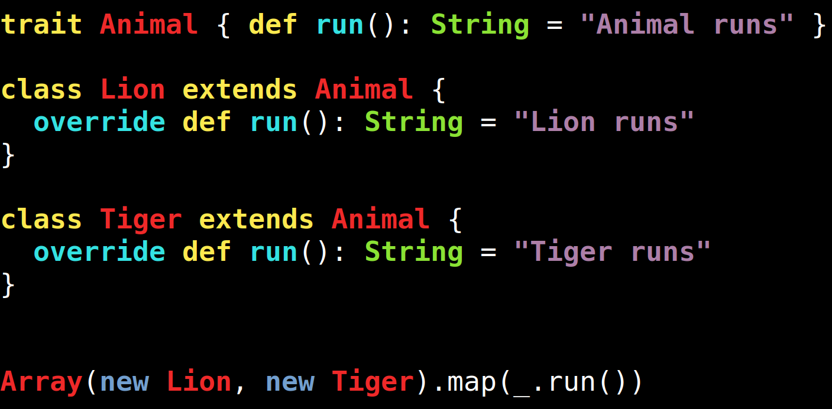
#1. Dynamic dispatch (Multiple representation)
Dispatch = send a message = method call
Dynamic:
  The actual method to call is determined at runtime, not at compile time.
→ same method name, different behavior

Slide 5
Question on C++
Code:
class Foo {
private int x;
public void bar(Foo y) {
return x + y.x;
}}
y.x okay?
y.x not okay?

Slide 6
#2. Encapsulation (Information hiding)
Principle
  hide an object's internal representation from the outside
  control access to an object's internal state
To access internal details, you should explicitly call:
  getter methods (for reading)
  setter methods (for updating)
Ex. Access modifiers in Java
  private
    class-level private fields
    cannot be accessed even in subclasses (why???)
  no modifier
    can be accessed from classes in the same package
  protected
    can be accessed in subclasses
  public

Slide 7
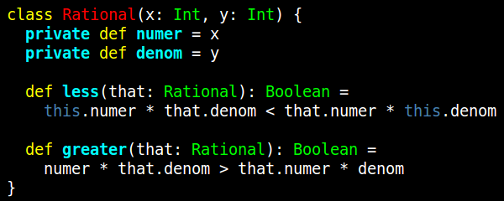
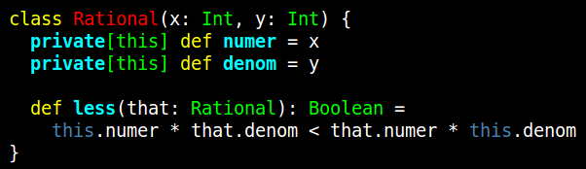
Example: Object-level private in Scala
class-level private
object-level private

Slide 8
#3. Subtyping
Principle of subtyping
  A is a subtype of B if an expression of type A can be used in any context wherever an expression of type B is expected
Implements a form of polymorphism
  because the same code can operate on different types
class Foo extends Bar
f(new Foo());
f(new Bar());

Slide 9
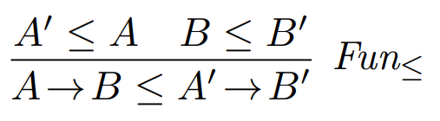
Covariance and Contra-variance of function types
You can override methods (but not fields) in Java.
class Foo {
B' myFun(A' arg) { ... }
}
class Bar extends Foo {
@Override
B myFun(A arg) { ... }
}

Slide 10
#4. Inheritance
Mechanism of code reuse in object-oriented languages
In general, inheritance is independent of subtyping.
  Inheritance is a relation between implementations.
  Subtyping is a relation between types.
    Ex. Int32 vs Int64 where Int32 can be automatically converted to Int64
However, inheritance is best used when subtyping is implied.
class Foo {
int count;
void increment() { count = count + 1; }
}
class Bar extends Foo
class Stack extends Vector { ... } // bad example

Slide 11
Inheritance (with Subclassing) adds to the complexity of the code
Real-world example
NullPointerException: super() → Exception occurs → close() → NPE
public class RecordReaderImpl extends BasecordReader {
private final Batch batch;
RecordReaderImpl(...) {
super(...); // may throw Exception
batch = createBatch(); // not initialized
}
public void close() {
super.close();
batch.deallocate(); // NPED
}
}

Slide 12
Inheritance (with Subclassing) adds to the complexity of the code
https://issues.apache.org/jira/browse/HIVE-27473

Slide 13
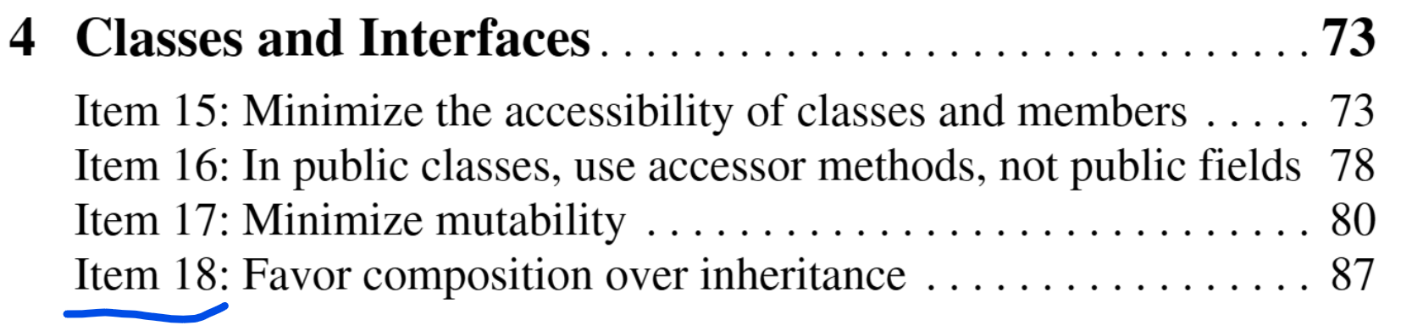
Inheritance is often unsafe
Inheritance is usually safe to use if:
  subclass and superclass implementations are under the control of the same programmer
Inheritance violates encapsulation.
  A subclass depends on the implementation details of its superclass.
  If the superclass's implementation changes, bad things can happen.
Always think twice before using inheritance
Prefer composition over inheritance
  Cf. Effective Java

Slide 14
Example
// inheritance
class Stack extends Vector { ... }
// no inheritnace
class Stack[T] {
private Vector[T] stack;
void push(T elem) { ... }
T pop() { ... }
}

Slide 15
Example of Composition - Decorator Pattern
Extends the functionality of an object (not a class)
  without affecting other instances of the same class
  without creating a subclass, i.e., without using inheritance
Multiple decorators can be stacked.
Object X
Decorator A
Decorator B
Decorator C
Object Y
Decorator B
Decorator A
Decorator C
Object Z
Decorator C
Decorator B
Decorator A

Slide 16
Decorators Stacked Together
X.foo() prints:
C
B
A
foo
Object X
foo() = {
print(“foo”)
}
Decorator A
foo() = {
print(“A”)
super.foo()
}
Decorator B
foo() = {
print(“B”)
super.foo()
}
Decorator C
foo() = {
print(“C”)
super.foo()
}

Slide 17
Decorator Patterns in Java
An intermediate decorator class is used.
interface Shape
abstract class
ShapeDecorator
class Circle
class Box
class
ColorDecorator
class
LineDecorator

Slide 18
Decorator Patterns in Java
interface Shape
draw()
abstract class ShapeDecorator
Shape decoratedShape;
draw() { decoratedShape.draw(); }
class Circle
draw() { … }
class Box
draw() { … }
class ColorDecorator
draw() {
decoratedShape.draw();
// add color
}
class LineDecorator
draw() {
decoratedShape.draw();
// add line
}

Slide 19
Decorating Objects in Java
Shape circle = new Circle
Shape colorCircle = new ColorDecorator(circle)
Shape lineColorCircle =
new LineDecorator(colorCircle)

Slide 20
Example of Composition - Dependency Injection
The client requires a service, but does not build it.
We pass the service to the client.
Client behavior:
  Fixed
  Configurable (as in testing)
Service
: Dependency
interface
: Injection
Client
: Dependent

Slide 21
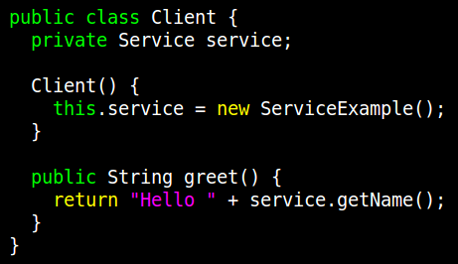
Without Dependency Injection
The client creates the service in the constructor.
Hard-coded dependency

Slide 22
#5. Open recursion (Self-reference)
Ability to access other methods inside the same class
  via a special variable
    this.foo()
    self.foo()
  before the definition of the class is completed
  open:
    the implementation of the target method is open, i.e., can be chosen dynamically
Cf. Closed recursion
class T {
void foo() { ... this.bar(); }
abstract void bar();
}
void foo() { ... foo(); }

Slide 23
Q & A

